Slide 1
POWER BI

Slide 2
LESSON 1:
Collaboration with Power BI Service

Slide 3
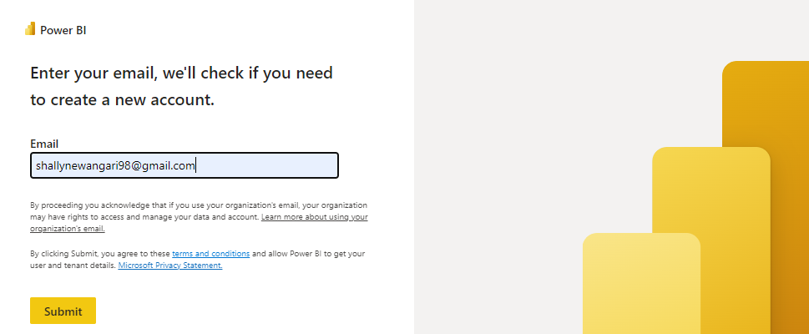
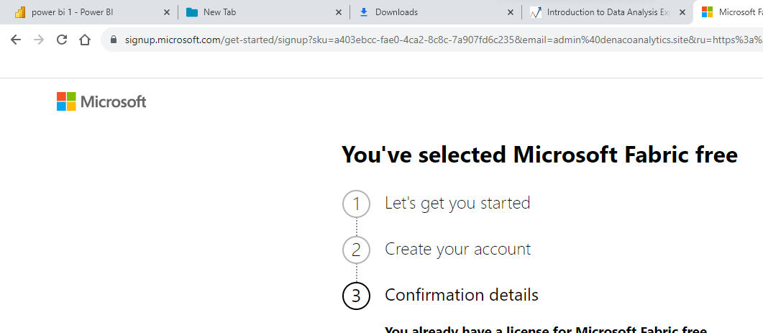
Connecting to data sources using the Power BI web app
Power BI service is a cloud-based Software as a Service (SaaS) online platform and can be used for report creation, report editing, and data ingest, as well as for sharing, collaborating, and viewing reports.
Follow these steps to register for a trial of Power BI
In a web browser, enter https://powerbi.com and run.
Enter your work or student email address and follow the prompts from there.

Slide 4
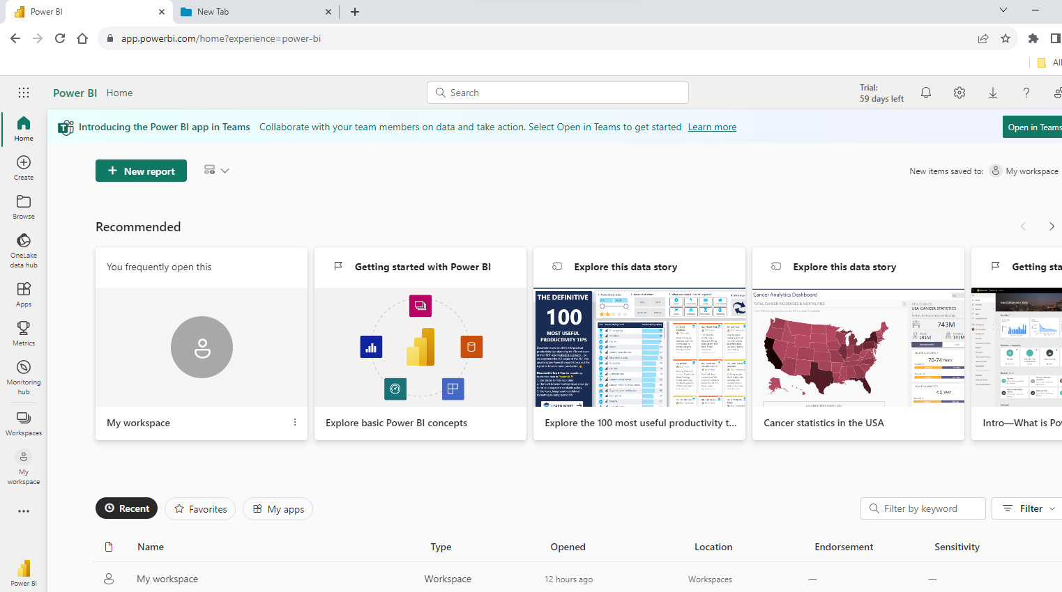
Connecting to data sources using the Power BI web app
After signing up and activating your Power BI trial, you are ready to log in to the service.
Publishing and sharing work is typically done through the Power BI service

Slide 5
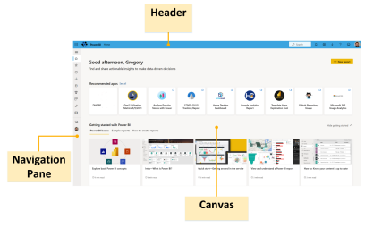
Workspaces in the Power BI service
Once logged in to the service, the Power BI service interface is somewhat important of the Power BI Desktop interface, although simpler.
The Power BI service's user interface is comprised of three main areas

Slide 6
Workspaces in the Power BI service
Header
The header area contains a number of useful items. On the far left is a waffle icon that, when clicked, provides links to other Office 365 applications. On the right-hand side of the Power BI text is a breadcrumb widget that helps you to keep track of where you are within the Power BI service. On the right-hand side of the screen, there is a Search bar and some icons.
Navigation pane
Initially collapsed, the navigation pane can be expanded by using the pancake icon (three horizontal lines) at the top. Clicking this icon will reveal the Show the navigation pane option. Once expanded, clicking this icon again will reveal the Hide the navigation pane option. The navigation pane contains a number of useful navigational links
Canvas
Similar to the Canvas area in the Desktop, the particular content and use of the Canvas area in the service depend on exactly where you are in the service and what you are doing. Suffice to say, this is the main area where you will look at reports and interact with the service

Slide 7
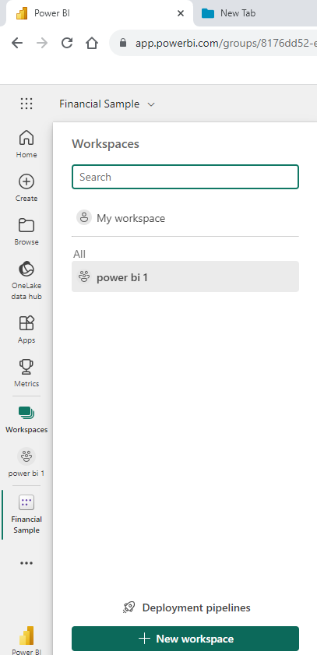
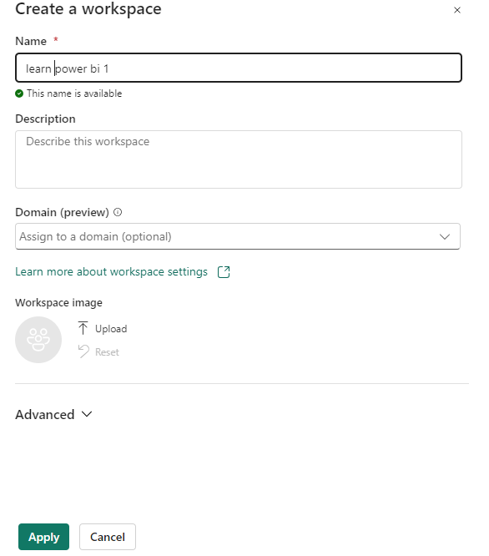
Workspaces in the Power BI service
Creating a workspace
A workspace is specifically for the reports that will be published to the service,
Steps to create a workspace;
Click on Workspaces and then, at the bottom of the fly-out menu, click Create new workspace. The Create a workspace dialog is displayed on the right-hand side of the screen.
Enter a name for the workspace, such as Learn Power BI 1, and then click the Save button. The new workspace is created, and you will end up on the workspace home page
We have created a workspace and we can publish our report.

Slide 8
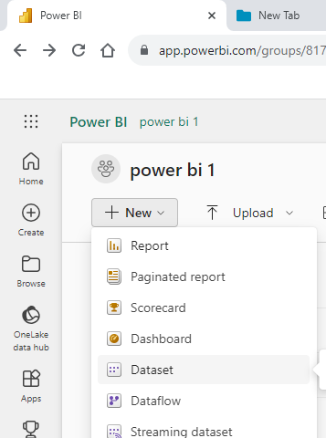
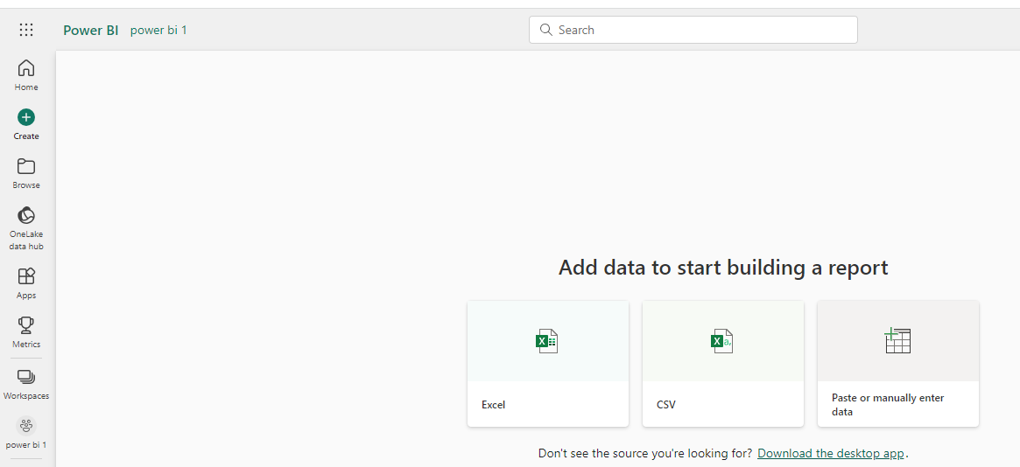
Workspaces in the Power BI service
Creating a workspace
My workspace in the navigation pane.
1. Select New > Dataset to initiate the import process. The Add data to start building a report page opens.
Note: If you select Upload instead of New, the Power BI service uploads the entire Excel workbook. You can then open and edit the workbook in Excel Online.
2. On the Add data to start building a report page, select Excel.

Slide 9
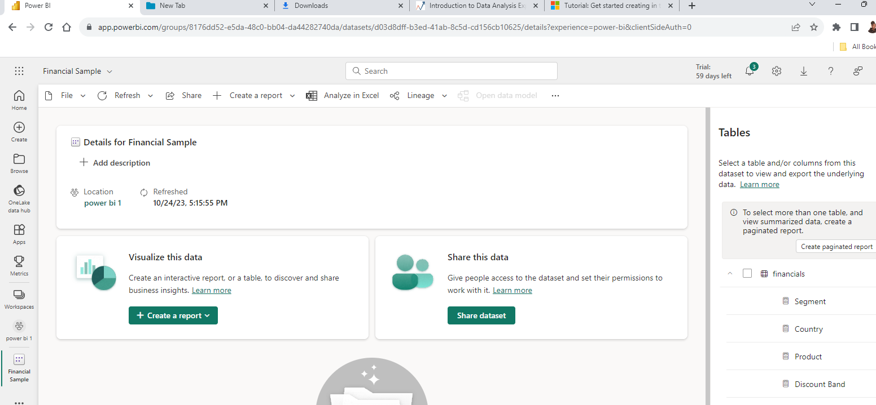
Workspaces in the Power BI service
3. In the Select a file dialog, browse to the location where you saved the Excel file on your computer.
Select the file and choose Import.
The Power BI service imports the sample data from the Excel file as a dataset and opens the Financial Sample page.
You can now use the sample dataset to create reports and dashboards.

Slide 10
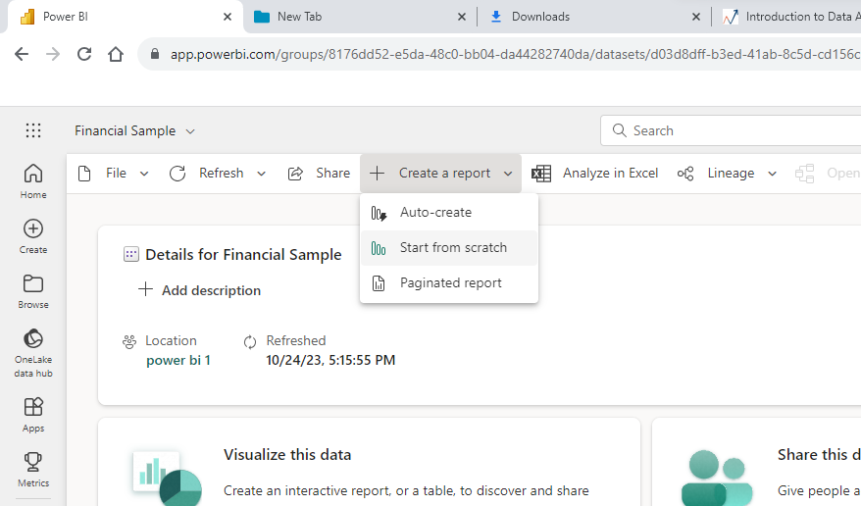
Workspaces in the Power BI service
4. On the Financial Sample dataset page, at the top, select Create a report > Start from scratch to open the report editor.
The Power BI service opens the new report in My workspace. The report canvas is blank and shows the Filters, Visualizations, and Data panes.

Slide 11
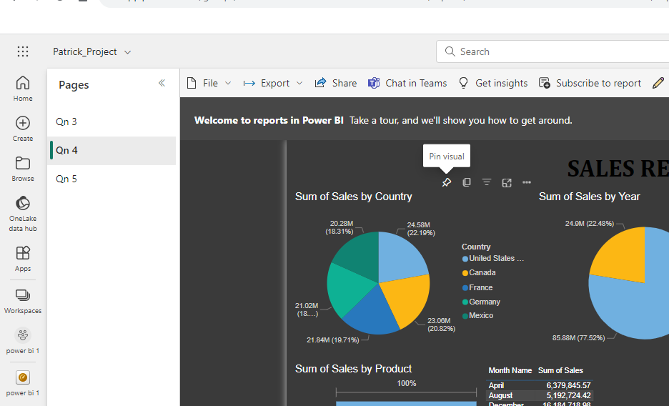
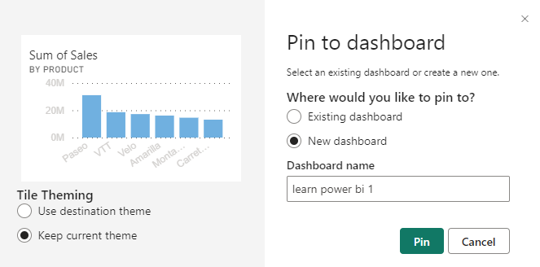
Creating a dashboard in the Power BI service
Understanding dashboards Dashboards are single-page canvases that contain visualizations called tiles.
These tiles are visualizations that are pinned from reports, other dashboards, Question and Answer (Q&A) displays, or other sources such as quick insights. Single visuals or entire report pages can be pinned.
Steps to pin visual
Make sure that you are viewing a report in the service.
Hover your mouse over any of the visualizations on the page and note that several icons appear in the upper-left corner of the visualization.
Click the Pin visual icon, which may show up at the top or the bottom of the visual. The Pin to dashboard dialog is displayed
Enter Learn Power BI 1 in the Dashboard name field and then click the Pin button
The name Learn Power BI 1 now appears under the Dashboards sub-heading for the workspace in the Navigation pane. Clicking on this dashboard displays the pinned visualization as a tile on the dashboard.
We have created a simple dashboard and we can explore how to work with dashboards in the service.

Slide 12
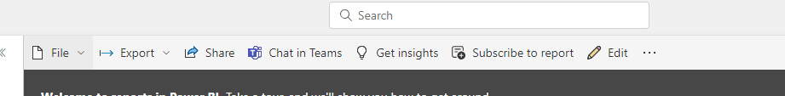
Reports in the Power BI service
The difference between Power BI Desktop and the Power BI service that most users will notice is that there is a Pages pane located to the left of the report versus the Page tabs in the Desktop version.
All pages in the report except for hidden pages will be listed in the Pages pane while the functions for reports within the service can be accessed by using the slim ribbon bar that appears above your report.
The File menu provides a variety of important options and features for managing and working with reports while in the service.
The Export menu provides three different options, as follows;
PowerPoint
PDF
Analyze in Excel

Slide 13
LESSON 2:
Data Analysis and Visualization Techniques

Slide 14
Data analysis
Data analysis is a process of inspecting, transforming, and monitoring to turn raw data into valuable insights.
Data Insights helps in making the required decisions for the growth of business and company.
To lead a data-driven approach for a business, it is important to analyze the data in deep
Power BI provides various tools and charts to analyze data efficiently. We will use some of the basic techniques for data analysis in Power BI to generate valuable insights.
The Analyze feature provides you with additional analysis that is generated by Power BI for a selected data point. You might want to use this feature to determine if Power BI has found something that you haven't seen before, or if you want Power BI to give you a different insight into your data. This feature is particularly useful for analyzing why your data distribution looks the way that it does.
Note: This feature does not work if you have non-numeric filters applied to your visual and/or if you have measure filters applied.
To use the Analyze feature, right-click a data point on the visual and then hover over the Analyze option to display two further options: Explain the increase and Find where the distribution is different. The options that are available will depend on the data point that you selected.

Slide 15
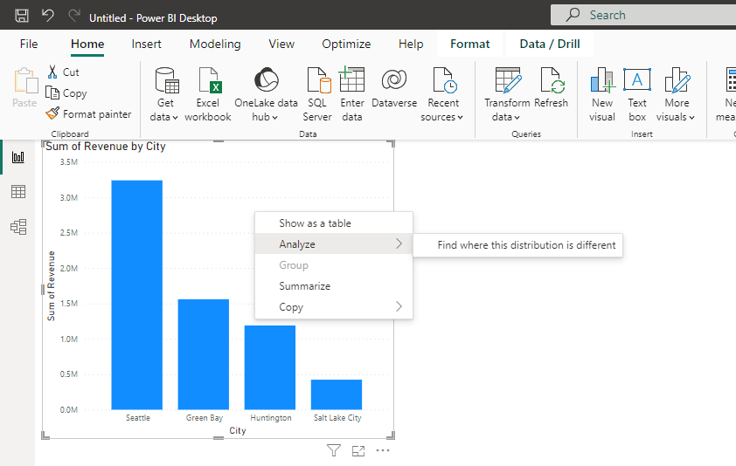
Data analysis
Select the find where this distribution is different. and a window displays with a new visual, as illustrated in the following

Slide 16
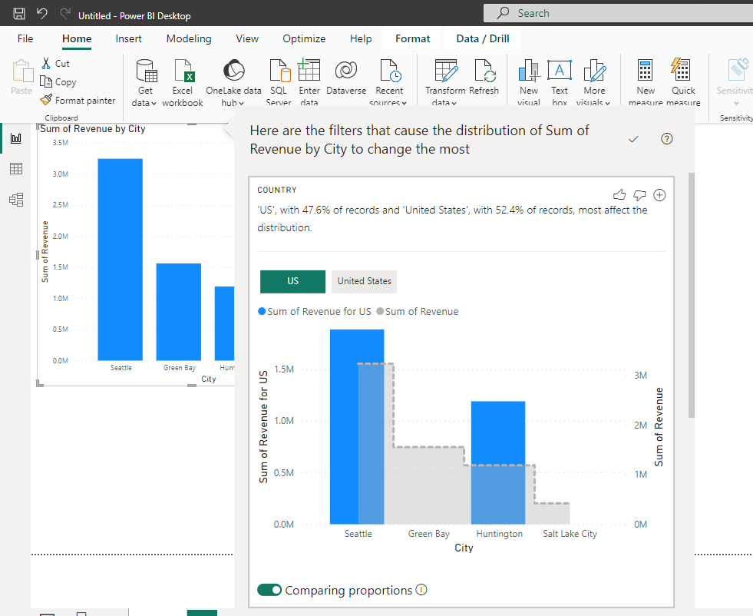
Data analysis
A window displays with a new visual, as illustrated in the following

Slide 17
Data analysis
Visit the ‘Reports‘ tab to start creating visuals and charts.
Select or drag any visualization and paste it on the screen. As shown in the above image, we used a stacked column chart on the left and an Area chart on the right.
Visit this ‘Fields‘ section to manage your charts or visualization.
These are all the properties of a chart, and these properties change depending on the chart you select. You can play with all these properties to learn them better. Let’s discuss some most used ‘Fields’ in a chart.
Axis – It is the X-Axis of the area chart. The fields section is currently assigned with Country Codes in the above image, and the same is reflected in the chart on the X-Axis.
Legend – This field is used to compare data present in a single field. When some field like Country is assigned in Legend, the chart will show the country various colours to compare them easily.
Values – This is the Y-Axis of the area chart.
Click on the drop-down button present at the end of the values field. Here you can apply some operators on the values field.
Power BI will reflect all the changes you made in the fields section on the chart. Here, our graph will change the shape depending on the operator and the resultant values on the Y-Axis.
Play with different visualizations and the field settings to better learn the functioning of Power BI.

Slide 18
Data analysis
A function is a named formula within an expression. Most functions have required and optional arguments, also known as parameters, as input. When the function is executed, a value is returned. DAX includes functions you can use to perform calculations using dates and times, create conditional values, work with strings, perform lookups based on relationships, and the ability to iterate over a table to perform recursive calculations. If you are familiar with Excel formulas, many of these functions will appear very similar; however, DAX formulas are different in the following important ways:
A DAX function always references a complete column or a table. If you want to use only particular values from a table or column, you can add filters to the formula.
If you need to customize calculations on a row-by-row basis, DAX provides functions that let you use the current row value or a related value as a kind of parameter, to perform calculations that vary by context. To understand how these functions work, see Context in this article.
DAX includes many functions that return a table, rather than a value. The table is not displayed in a reporting client, but is used to provide input to other functions. For example, you can retrieve a table and then count the distinct values in it, or calculate dynamic sums across filtered tables or columns.
DAX functions include a variety of time intelligence functions. These functions let you define or select date ranges, and perform dynamic calculations based on these dates or range. For example, you can compare sums across parallel periods

Slide 19
Statistical functions
Statistical functions calculate values related to statistical distributions and probability, such as standard deviation and number of permutations.
MEDIAN Returns the median of numbers in a column.
MEDIANX Returns the median number of an expression evaluated for each row in a table.
NORM.DIST Returns the normal distribution for the specified mean and standard deviation.
NORM.S.DIST Returns the standard normal distribution (has a mean of zero and a standard deviation of one).
POISSON.DIST Returns the Poisson distribution.
RANK.EQ Returns the ranking of a number in a list of numbers.
RANKX Returns the ranking of a number in a list of numbers for each row in the table argument.
SAMPLE Returns a sample of N rows from the specified table.
STDEV.P Returns the standard deviation of the entire population.
STDEV.S Returns the standard deviation of a sample population.
STDEVX.P Returns the standard deviation of the entire population.
STDEVX.S Returns the standard deviation of a sample population.
VAR.P Returns the variance of the entire population.
VAR.S Returns the variance of a sample population.
VARX.P Returns the variance of the entire population.
VARX.S Returns the variance of a sample population.

Slide 20
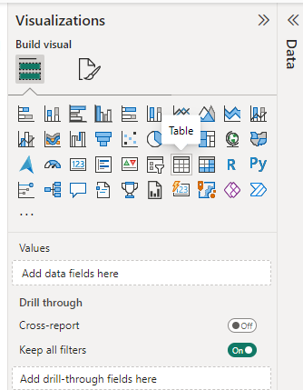
Geographical data and maps
Power BI offers many interactive map visualizations to help you understand your geographic data. Power BI Mapping visualizations condense the information supplied to the viewer and highlight key points based on the analysis.
Creating a Map, You can find it among all other visualization choices.

Slide 21
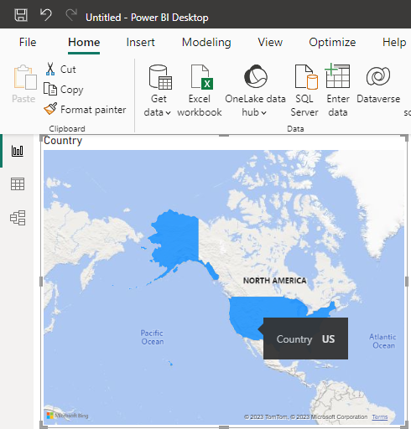
Geographical data and maps
Filled map

Slide 22
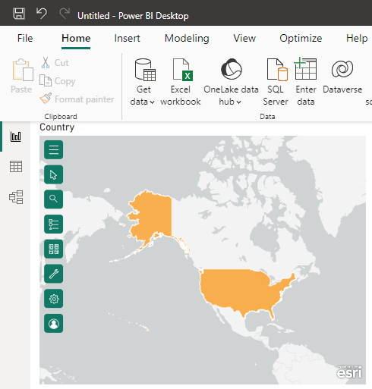
Geographical data and maps
Creating a Map Using ArcGIS for Power BI
ArcGIS is a built-in visual in Power BI. You can find it among all other visualization choices.

Slide 23
LESSON 3:
Advanced Visualizations and Custom Visuals

Slide 24
Data visualization is a crucial aspect of data analysis as it allows us to communicate complex information in a clear and visually appealing way.
Power BI provides a wide range of advanced visualization features that can help us unlock deeper insights from our data and create interactive, dynamic, and engaging reports.

Slide 25
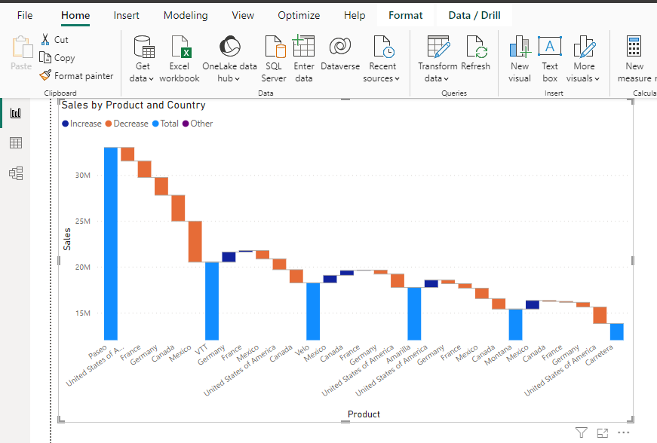
Advanced Chart
Power BI offers a wide range of advanced chart types that go beyond the basic bar and line charts.
These advanced chart types can provide deeper insights into our data and help us uncover hidden patterns and trends. Some of the advanced chart types in Power BI include funnel charts, waterfall charts, and box and whisker plots, among others.
For example if we want to analyze sales and understand the sales performance of different products across various regions, we can use a waterfall chart to visualize the sales performance, which shows the changes in sales from one category to another in a waterfall-like format. This can help us identify which products and regions are driving the most sales and where we need to focus our efforts.

Slide 26
Custom Visuals
Power BI offers a rich library of built-in visualizations, but sometimes we may need to create custom visualizations to address specific data analysis requirements.
Power BI allows us to add custom visualizations developed by the community or create our own using the Power BI SDK. This gives us the flexibility to create unique and specialized visualizations that cater to our specific data visualization needs.
Example
Let's say we want to visualize data using a radial tree map to represent hierarchical data.
We can search for a custom visualization in the Power BI community and find a radial tree map visual that can be easily imported into our Power BI report.
This allows us to create a visually stunning and informative radial tree map visualization that is not available in the default Power BI visualization library.

Slide 27
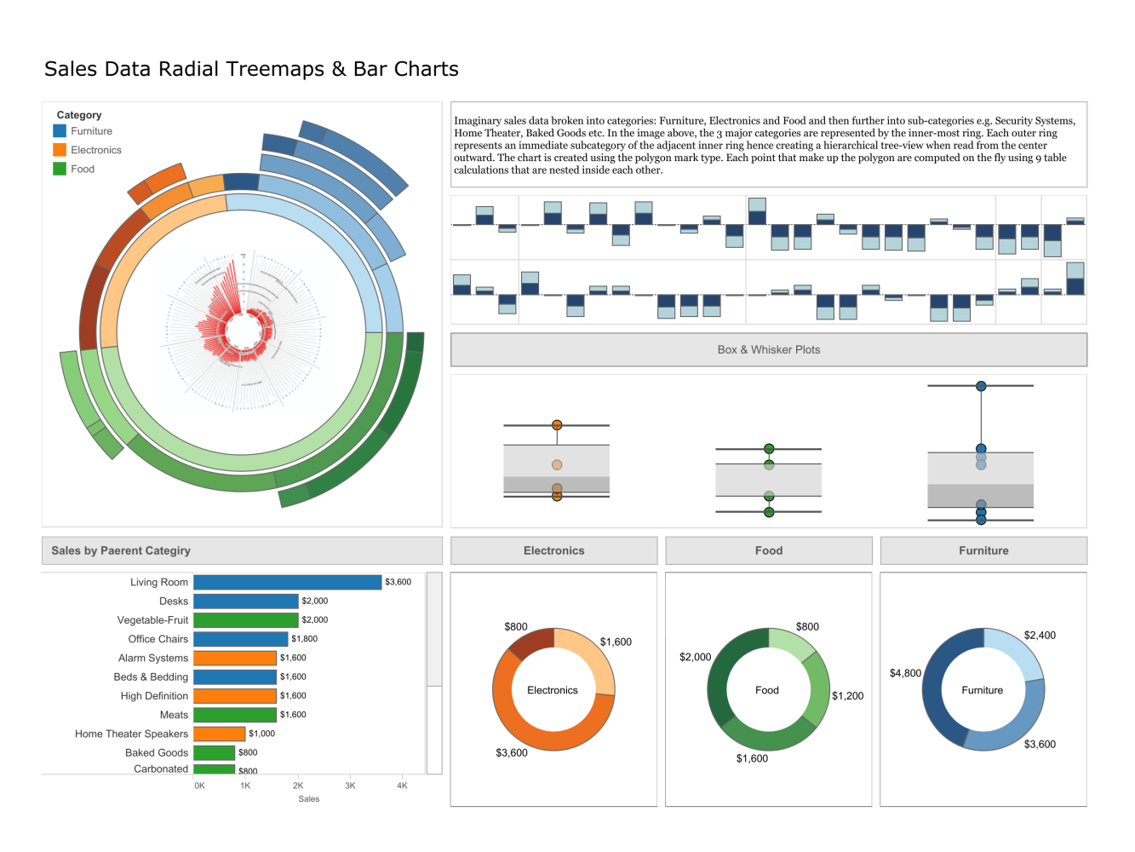
Custom Visuals

Slide 28
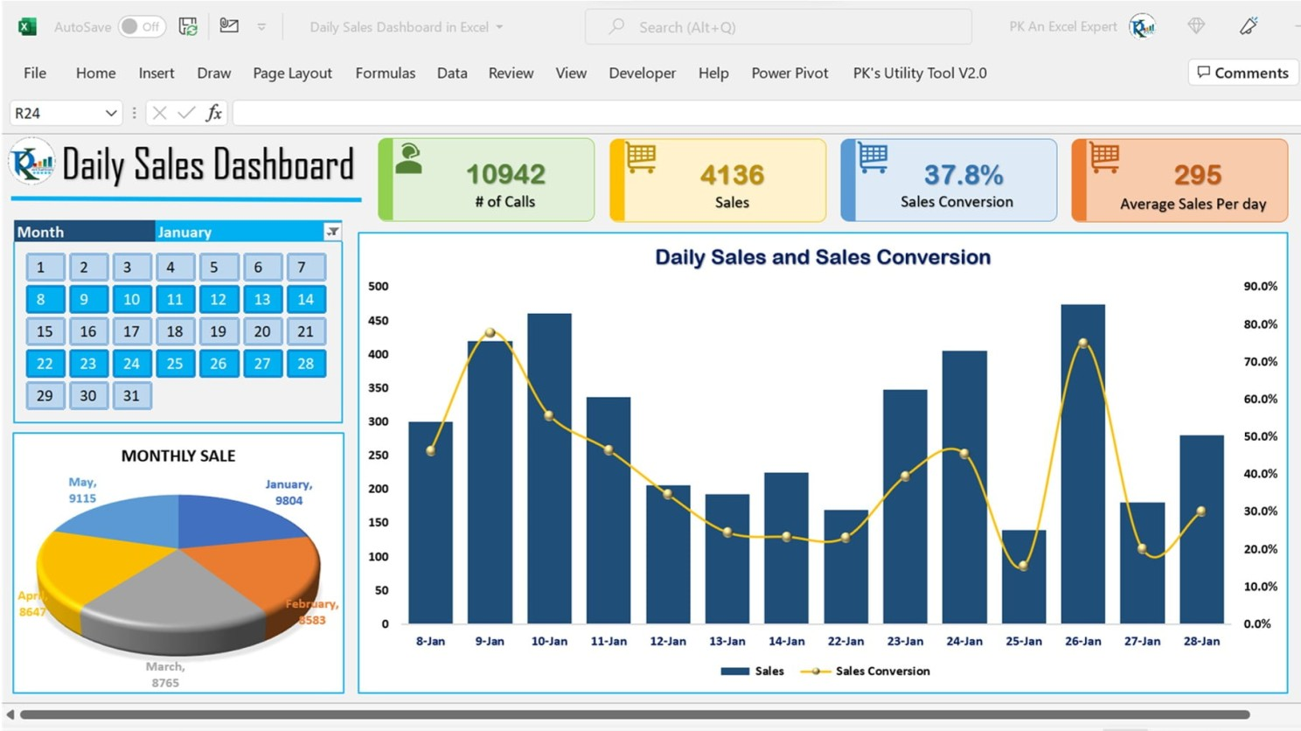
Color theme and design aesthetic
Data-driven Alerts and Conditional Formatting
Power BI allows us to set up data-driven alerts and conditional formatting to draw attention to specific data points or trends that require action.
We can define rules based on our data and set up alerts or apply conditional formatting to our visualizations to highlight data that meets certain criteria. This can help us quickly identify outliers, anomalies, or trends in our data and take appropriate action.
Let's say we have a KPI dashboard that tracks sales performance against targets. We can set up data-driven alerts that trigger when sales fall below a certain threshold or when a particular product's sales exceed a predefined limit. This can help us quickly identify underperforming regions or overperforming products and take corrective actions in real time, ensuring that we stay on top of our sales targets.

Slide 29
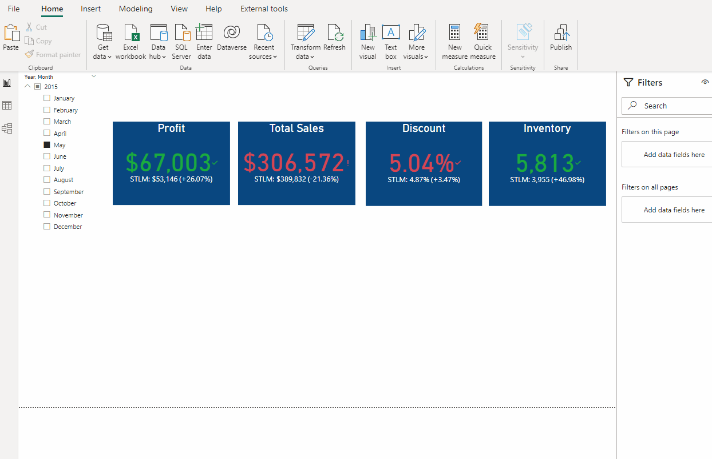
Advanced-Data Visualization Techniques
Power BI offers several advanced data visualization techniques that can enhance the visual appeal and effectiveness of our reports.
Some of these techniques include the use of custom visuals, layering multiple visuals, using bookmarks and drill-through, and creating dynamic tooltips.
Let's say we want to create a custom visual that displays sales data in a heatmap format, where the colour intensity represents the sales performance. We can use a custom visual from the Power BI community or create our own using the Power BI SDK. We can then layer this custom visual on top of a map visualization to create a powerful and visually appealing heatmap representation of our sales data. We can also use bookmarks and drill-through to create interactive navigation within our report, allowing users to explore different aspects of the data in more detail. Additionally, we can create dynamic tooltips that show additional information when users hover over data points, providing contextual insights without cluttering the report

Slide 30
LESSON 4:
Real-World Project and Assessment

Slide 31
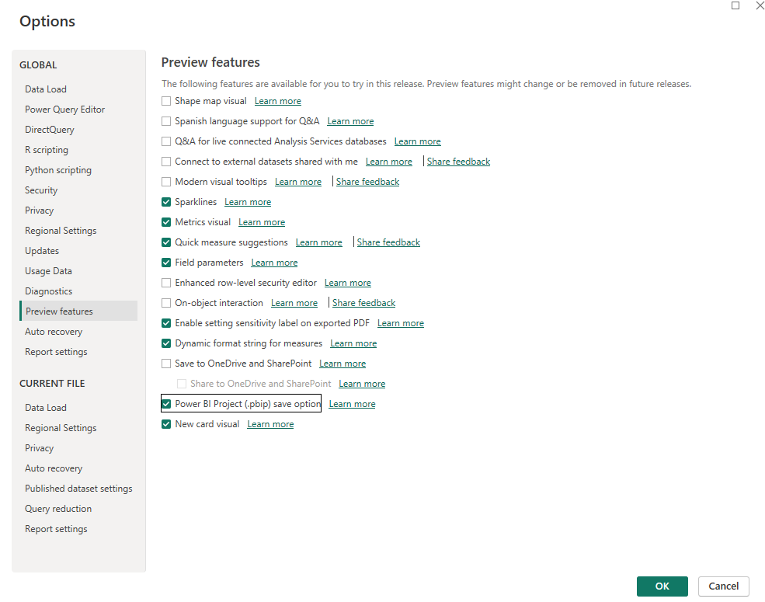
Enable preview features
Saving as a project in Power BI Desktop is currently in preview. Before giving it a try, you must first enable it in Preview features.
To enable, in Power BI Desktop > File > Options and settings > Options > Preview features, select the checkbox for Power BI Project (.pbip) save option.

Slide 32
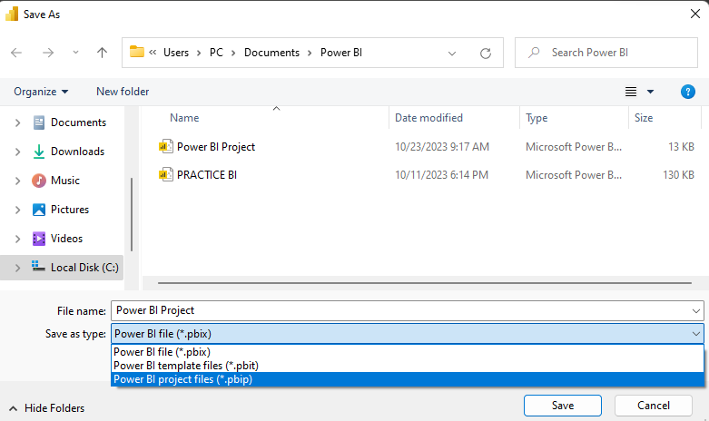
Save as a project
On the new project, save your work as a Power BI project file (pbip)

Slide 33
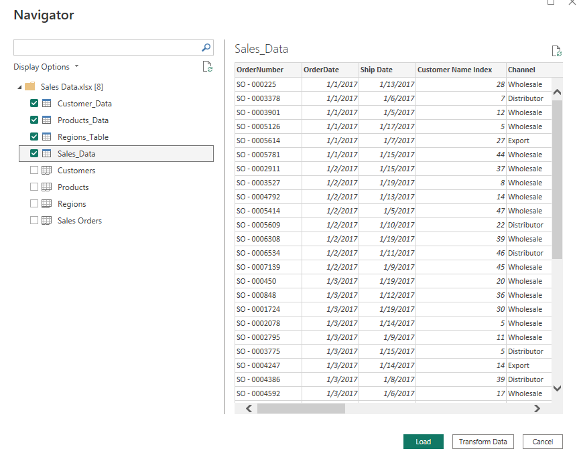
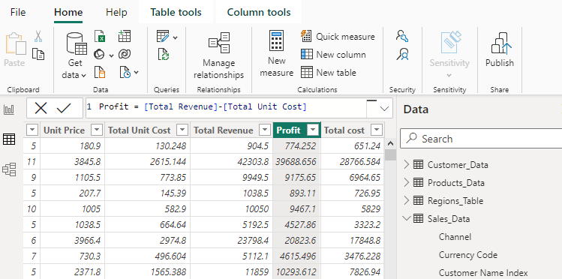
Get data
Load and transform the data
Create a new DAX expression column for profit and total cost

Slide 34
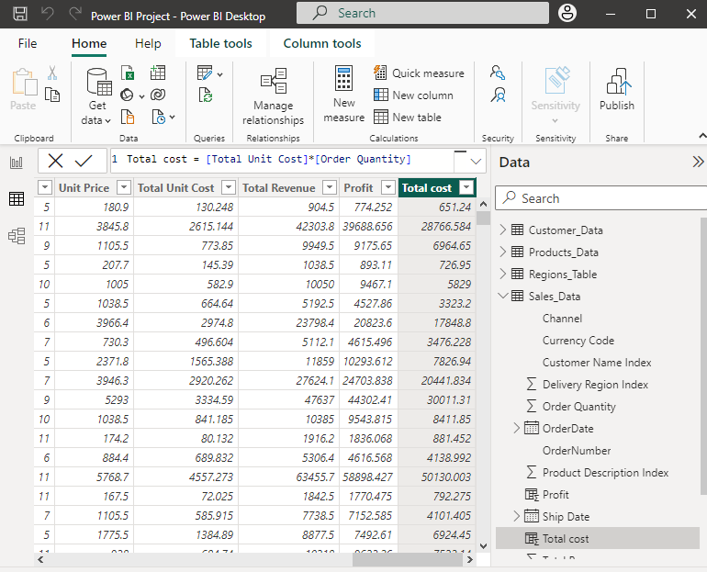
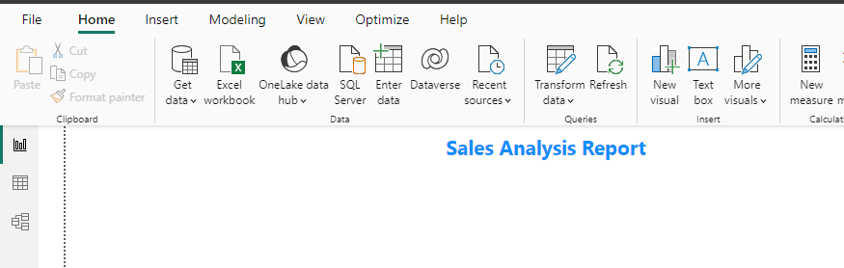
Add a title to your report

Slide 35
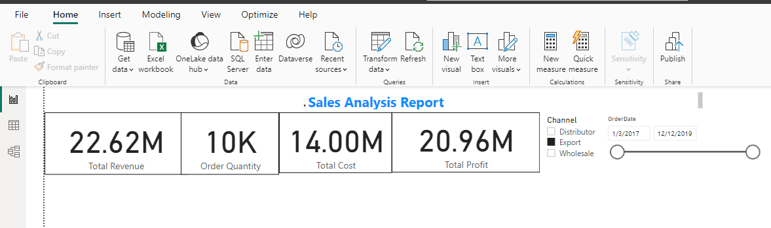
Total distributions over time

Slide 36
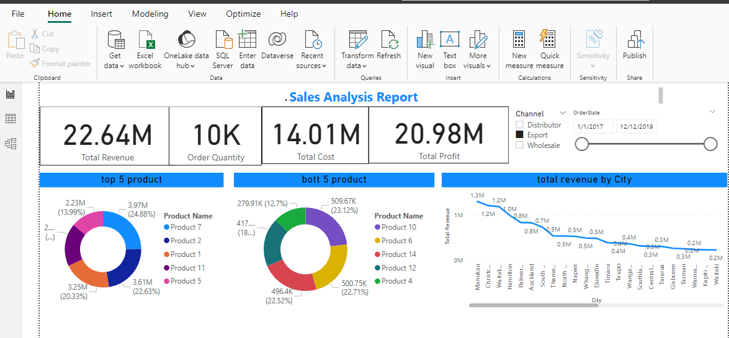
Sales performances through products and regions

Slide 37
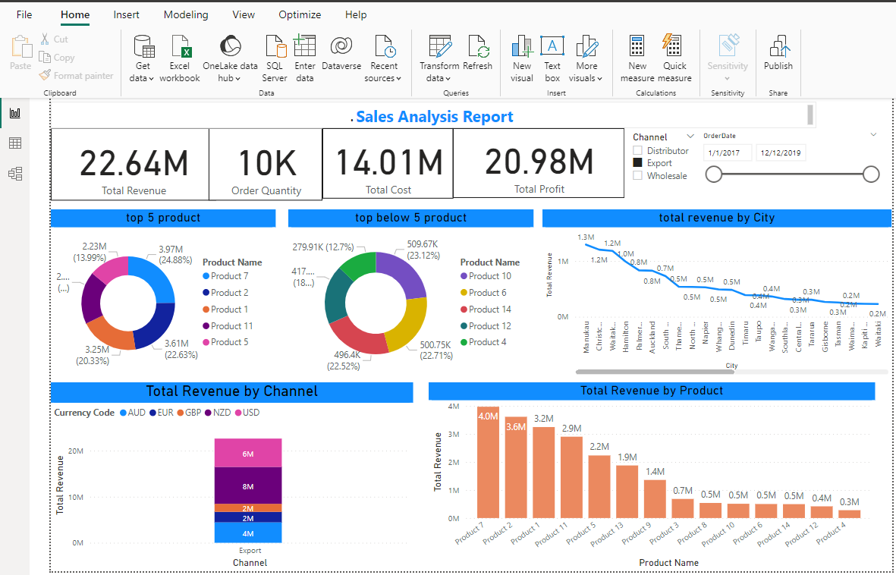
Sales analysis final dashboard

